Slide 1
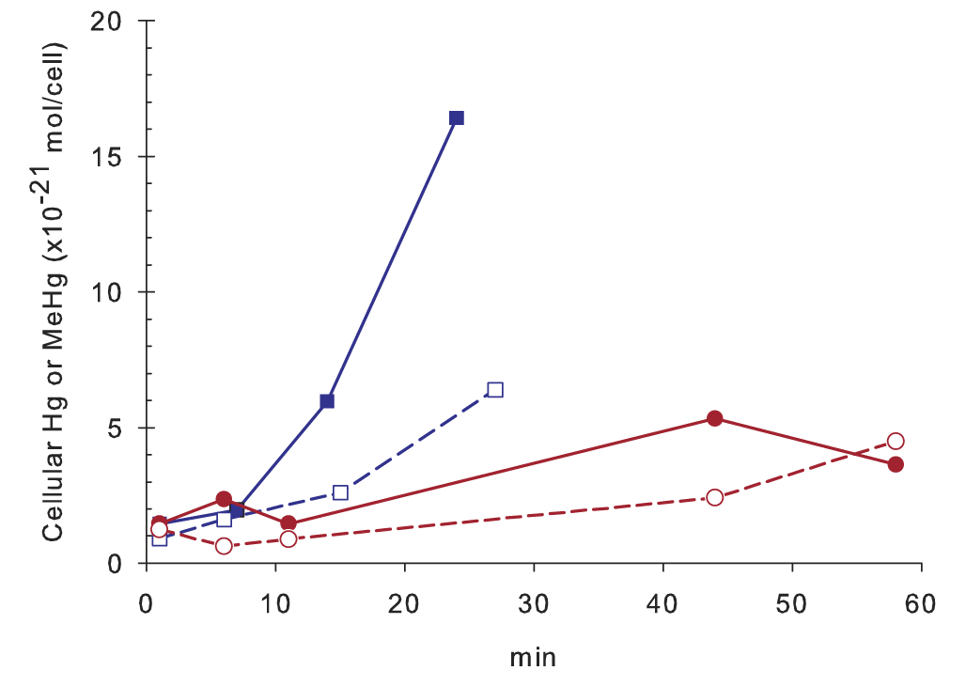
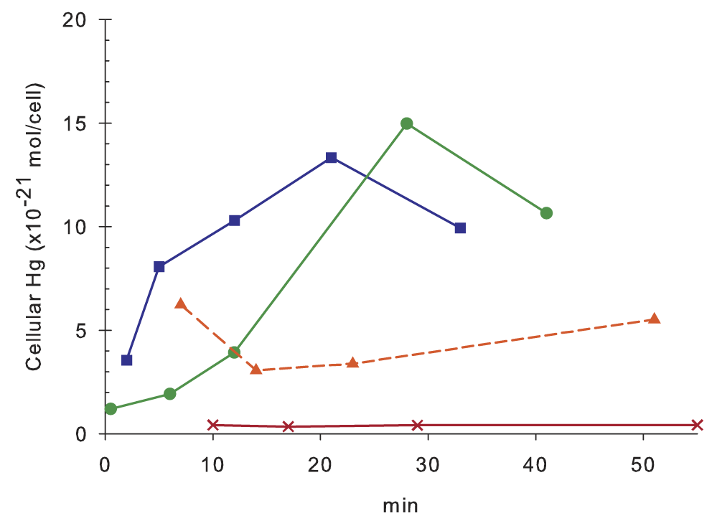
A new mechanism of mercury (Hg) uptake and methylation in anaerobic bacteria
Contact: Jeffra Schaefer(jschaefe@princeton.edu, 609-258-7438)
Objective
Elucidate the mechanism(s) of Hg uptake in methylating bacteria and effects on Hg methylation in nature
New Science
Hg(II) uptake is an active transport process requiring energy; not a passive process as commonly perceived
Hg(II) uptake and methylation is highly dependent upon the chemical characteristics of the complexing thiols in Geobacter sulfurreducens, but less so in Desulfovibrio sp. ND132
Methylmercury is exported out of the cell immediately upon its production
Significance
Our data provides an updated model for the transport of Hg into and out of the microbial cells, suggesting a possible detoxification mechanism for the formation and export of methylmercury
Hg(II) uptake and methylation
by Desulfovibrio sp. ND132
Hg_{cell}
-CCCP
CH₃Hg
+CCCP
Hg uptake of Hg-thiol complexes
by G. sulfurreducens
2MPA
cys
Pen
GSH
J. K. Schaefer, S. S. Rocks, W. Zheng, B. Gu, L. Liang, and F. M. M. Morel. 2011. Proc. Natl. Acad. Sci. USA (in press).
1 BER Overview
Department of Energy • Office of Science • Biological and Environmental Research

Slide 2
Active Transport, Substrate Specificity, and Methylation of Hg(II) in Anaerobic Bacteria
Contact: Jeffra Schaefer(jschaefe@princeton.edu, 609-258-7438)
The formation of methylmercury (MeHg), which is biomagnified in aquatic food chains and poses a risk to human health, is effected by some iron and sulfate reducing bacteria (FeRB and SRB) in anaerobic environments. But very little is known regarding the mechanism of uptake of inorganic Hg by these organisms, in part because of the inherent difficulty in measuring the intracellular Hg concentration. Using the FeRB Geobacter sulfurreducens and the SRB Desulfovibrio desulfuricans ND132 as model organisms, we demonstrate that Hg(II) uptake occurs by active transport. We also establish that Hg(II) uptake by G. sulfurreducens is highly dependent on the characteristics of the thiols that bind Hg(II) in the external medium, with some thiols promoting uptake and methylation and others inhibiting both. The Hg(II) uptake system of D. desulfuricans has a higher affinity than that of G. sulfurreducens and promotes Hg methylation in the presence of stronger complexing thiols. We observed a tight coupling between Hg methylation and MeHg export from the cell, suggesting that these two processes may serve to avoid the build up and toxicity of cellular Hg. Our results bring up the question of whether cellular Hg uptake is specific for Hg(II), or accidental, occurring via some essential metal importer. Our data also point at Hg(II) complexation by thiols as an important factor controlling Hg methylation in anaerobic environments.
Schaefer, J. K., S. S. Rocks, W. Zheng, B. Gu, L. Liang, and F. M. M. Morel. 2011. Active transport, substrate specificity, and methylation of Hg(II) in anaerobic bacteria. Proc. Natl. Acad. Sci. USA (in press).
2 BER Overview
Department of Energy • Office of Science • Biological and Environmental Research

